Slide 1

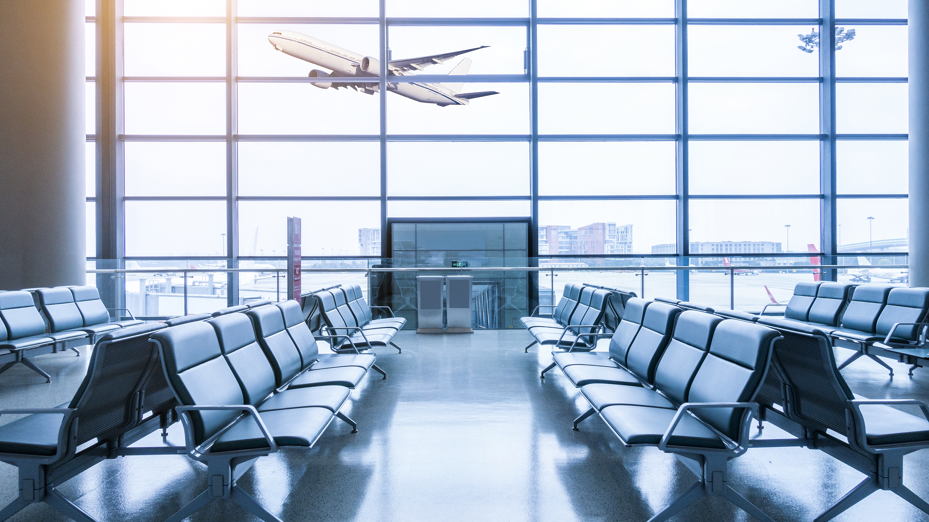
AIRLINES DELAY ANALYSIS (December 2021 to 2023)
ROHITTH MALLEBOINA,
RENUKA CHOWDARY PARVATHANENI,
SHASHIKUMAR GADUSU

Slide 2

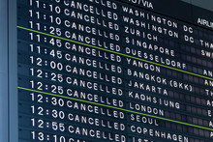

INTRODUCTION
Airline delays are a big problem. They cost airlines money, make customers unhappy, and hurt their reputation. This study looks at flight delays from December 2021 to 2023 to see why they happen. We got information from the Bureau of Transportation Statistics (BTS). This data has 1562 flights with 22 details about each flight, including why they were delayed. By studying this data, we hope to help airlines and airports find ways to make flights run on time more often.

Slide 3
Methodology • The Decision Tree model is more accurate at predicting flight delays than Logistic Regression (93.91% vs. 87.82%). • The Decision Tree model strikes a better balance between identifying true positives and avoiding false positives (precision-recall trade-off). • The Decision Tree model is better overall at reliably identifying flight delays (higher F1 score).
Models | Accuracy | Precision | F1 | Recall
1.Logistic Regression | 0.8782051 | 0.8778135 | 1.000000 | 0.9349315
2. Decision Tree | 0.9391026 | 0.9471831 | 0.985348 | 0.9658887

Slide 4
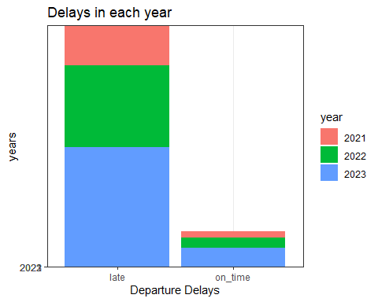
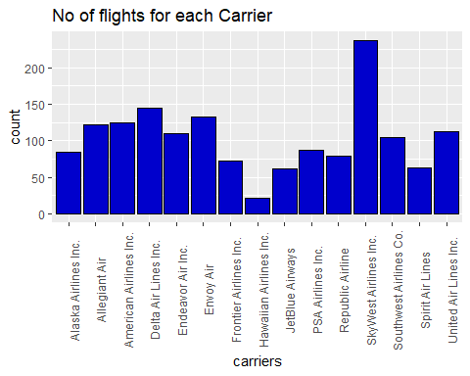
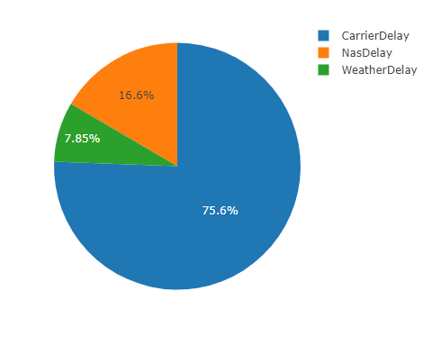
Findings
Year-wise improvement: Delays decreased from 2021 to 2023, suggesting successful strategies to improve departure times.
Carrier discrepancies: Airlines like SkyWest had higher delays, highlighting areas for improved efficiency.
Reason breakdown: Carrier issues were the biggest culprit, followed by weather and National Airspace System delays.

Slide 5
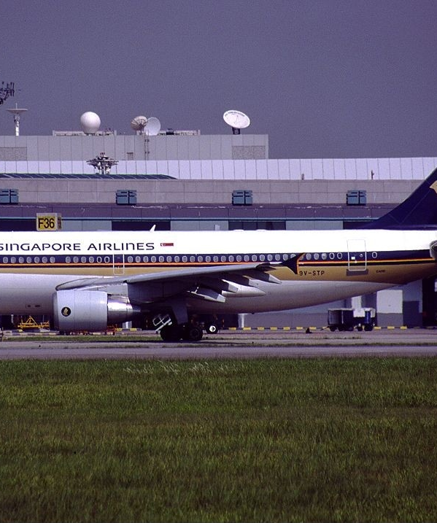
Implications and Strategies
Implications:
The findings emphasize the importance of data-driven decision-making for airlines and aviation authorities. Understanding delay factors enables targeted strategies to enhance operational efficiency and passenger experience.
Strategies:
1. Enhance Operational Efficiency
2. Improve Weather Forecasting
3. Implement Predictive Maintenance
4. Optimize Airspace Management
5. Enhance Communication and Coordination
Implementing these strategies can mitigate delays, improve passenger satisfaction, and enhance overall flight operations efficiency.
This Photo by Unknown Author is licensed under CC BY-SA

Slide 6
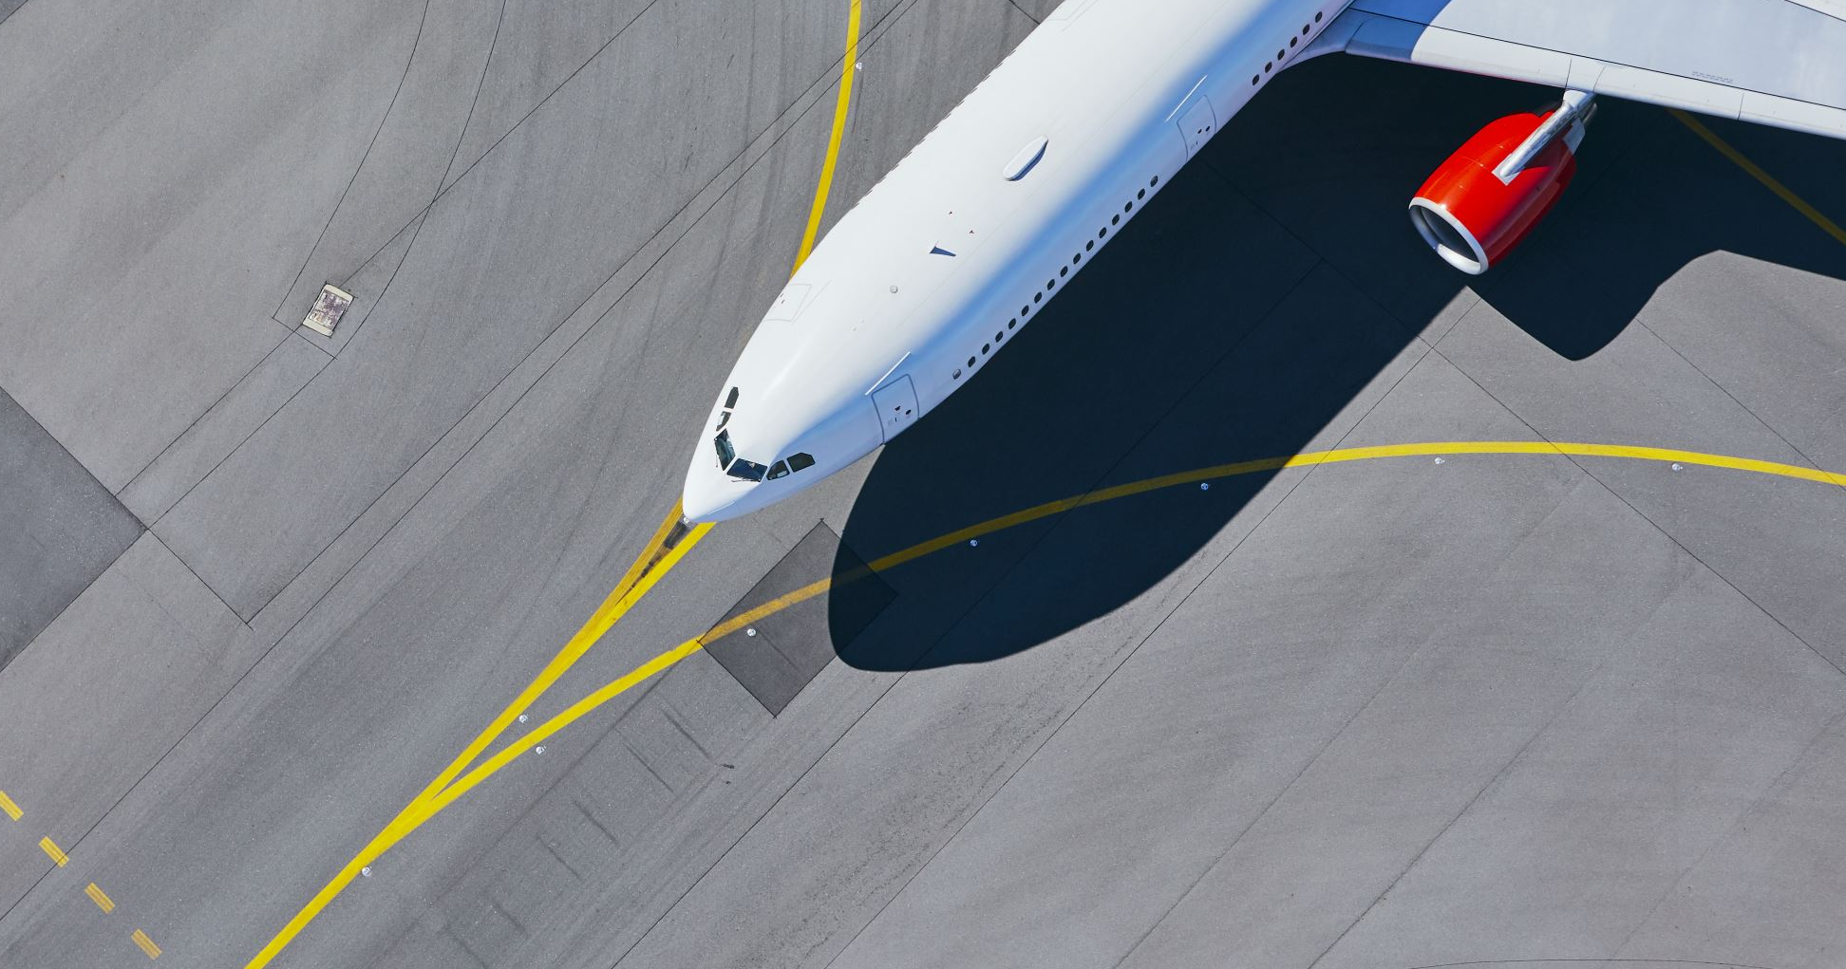
Recommdations: • Collaboration is key: Airlines and air traffic control need to work together to share data, plan schedules, and fix problems that cause delays. • Boost efficiency: Airlines can improve on-time performance by streamlining operations, managing crews better, and using new technology. This includes predicting and fixing problems before they delay flights. • Allocate resources wisely: Airlines should invest in keeping their planes in good shape, training staff, and improving airports. Air traffic control needs to manage airspace effectively and use modern systems to keep planes moving smoothly.

Slide 7

Conclusion:
Our analysis underscores the importance of proactive delay management in the airline industry. By implementing collaborative strategies, operational efficiency improvements, and effective resource allocation, stakeholders can mitigate flight delays and enhance passenger satisfaction. Proactive measures are essential for reducing operational costs and improving overall reliability in air transportation.

